Slide 1
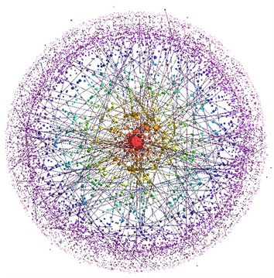

Complexity Metrics & Models
Kan, Ch 11
Steve Chenoweth, RHIT
Notes:
Complexity image from http://www.irvingbible.org/blog/post/in-defense-of-complexity/.

Slide 2
Dipping down to the code level…
What can we decide about quality, from the code itself?
This is real “computer science”
  Analysis of code design
  Can you predict defects from that?

Slide 3
Lines of Code, perhaps?
LOC = how many executable statements
Started as “How many machine instructions?”
Early studies – a negative relationship!
  More lines of code in a module →
  lower defect density
  Smaller modules have a higher density of interfaces, a main cause of errors

Slide 4
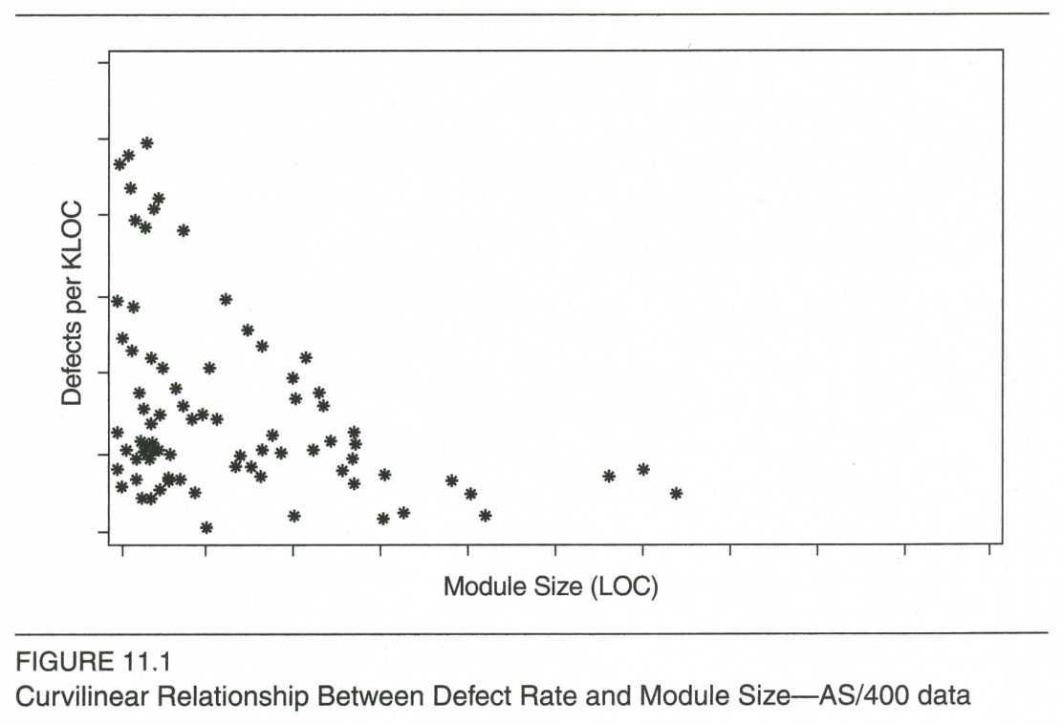
LOC, cntd
More recent studies – a concave curve
  “When module size becomes very large, the complexity increases to a level beyond a programmer’s
  immediate span of
  control and total
  comprehension.”
Notes:
Quote from Kan, p 312
Figure from Kan, p 313

Slide 5
Halstead’s Software Science
1977
Lots of formulas
Starts with operators (n1) and operands (n2), and their occurrences in a program.
“Vocabulary” n = n1 + n2.
“Length” N = n1 log2 (n1) + n2 log2 (n2).
“Volume” V = N log2 (n).
“Faults” B = V/S* , where S* = 3000 is the number of “mental discriminations” between errors).

Slide 6
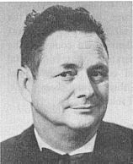

Halstead, cntd
His work was instrumental in making metrics studies an issue among computer scientists.
Kan thinks - Not that scientific
Oversimplified
Halstead, right, was also known as the “father of decompilation.” He worked at Purdue.
Looked a little like Bill Murray, left,
Notes:
Maurice Halstead pic from http://www.program-transformation.org/Transform/FatherOfDecompilation.
Bill Murray pic from http://designerlife.la/2014/02/07/the-coolest-100-americans-according-to-the-national-portrait-gallery/bill-murray/.

Slide 7
Cyclomatic Complexity
Due to McCabe (1976)
An “indication of testability and understandability.”
A classic graph theory calculation
Easy way: M = the number of binary decisions in a program + 1.
  An n-way decision counts as n-1 binary decisions.
  An iteration test in a loop counts as 1 binary decision.

Slide 8
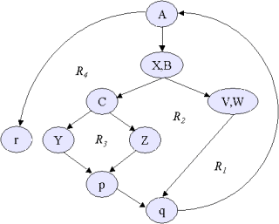
Cyclomatic Complexity, cntd
How about this one?
Notes:
Maybe, 3 decisions + 1 = 4 ?
Image from http://people.cs.aau.dk/~normark/oop-csharp/html/notes/test-note-cyclomatic-complexity-2.html.

Slide 9
Cyclomatic Complexity, cntd
Computer scientists love this one!
But, does it measure the defect rate?
  Moderate to strong correlations with defects.
  But, it also correlates with program size!
    If you take that out, not so much correlation with defects.
    Kan thinks this is because of “a lack of invetigational rigor.”
    Troster restored this by looking at rank-order correlation.

Slide 10
Other complexity studies
Maybe it’s loops, versus if-then-elses?
Maybe it’s the number of unique operands?
Lo’s equations – combined all these in formulas.
  Decided that the DO WHILE was a culprit he could reduce the use of.

Slide 11
Structure Metrics
Take into account interactions between modules.
  Many proposed models, not yet verified by empirical data from projects.
  Fan-in and fan-out have been studied more:
    Large fan-in not expected to correlate with defects.
    Large fan-out is expected to correlate with defects.
    Card & Glass’s study (1990):
      S = Σ f²(i) / n , where
      S = Structural Complexity
      F(i) = Fan-out of module I
      N = Number of modules in system
      So, structural complexity increases as the square of the connections between programs (fan-out).
      They found that Error rate = -5.2 + 0.4 * Complexity.
      Each unit increase in system complexity increased the error rate by 0.4 (errors per thousand lines of code).

Slide 12
Kan’s example
Showed how such metrics can be used to develop a software quality improvement plan.
Focused especially on cyclomatic complexity.
Development was for IBM AS/400 software.
  Written in PL/MI
  70 KLOC
  Most of the code originally for IBM System/38.

Slide 13
Kan’s example, cntd
Found that small changes are especially error-prone.
Correlation between previous defect history and current defect level was strongest.
  Many modules in a component are chronic problem components.
  Systematic plans and actions are needed for quality improvement.

Slide 14
Kan’s example, cntd
Found low defect rate for low complexity modules.
Used multiple regression model to look at effects of independent variables.
Controlled for program size.
Three most important factors affecting defect rates:
  Number of changes and enhancements
  Defect history
  Complexity level

Slide 15
Kan’s example, cntd
So, what did they do to improve quality?
  Scrutinized modules with moderate complexity yet high defect level.
  Restructured high-complexity chronic problem modules.
  Went after compilation warning messages.
  Used test coverage measurement tools.
  Improved component documentation and education.

Slide 16
Recommendations for small teams
Complexity metrics and models are small-team metrics.
  Measure the internal dynamics of design and code.
  Unit of analysis is usually the program-module.
  Recommend using small teams for improvements at this level.
  Main focus of study could be lines of code, cyclomatic complexity, fan-out, or specific syntactic constructs.
  Try to find empirical validity for defect rate assumptions.

